Slide 1
S-PARAMETERS

Slide 2
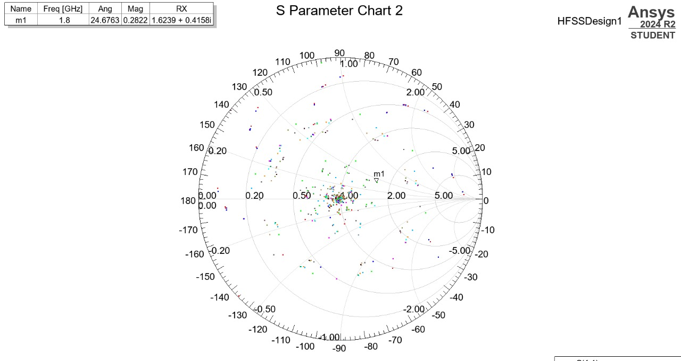

Slide 3
SMITH CHART BRIEFLY:
Smith Chart Explanation The Smith chart shows the variation of the reflection coefficient for the RF tuner at 1.8 GHz . Marker m1 indicates a reflection magnitude of 0.2822 at an angle of 24.68°, corresponding to a normalized impedance of 1.6239 + 0.4158i.
The spread of points across the chart represents different impedance states achieved by varying the tuner probe position, enabling impedance matching and device performance analysis.

